Slide 1
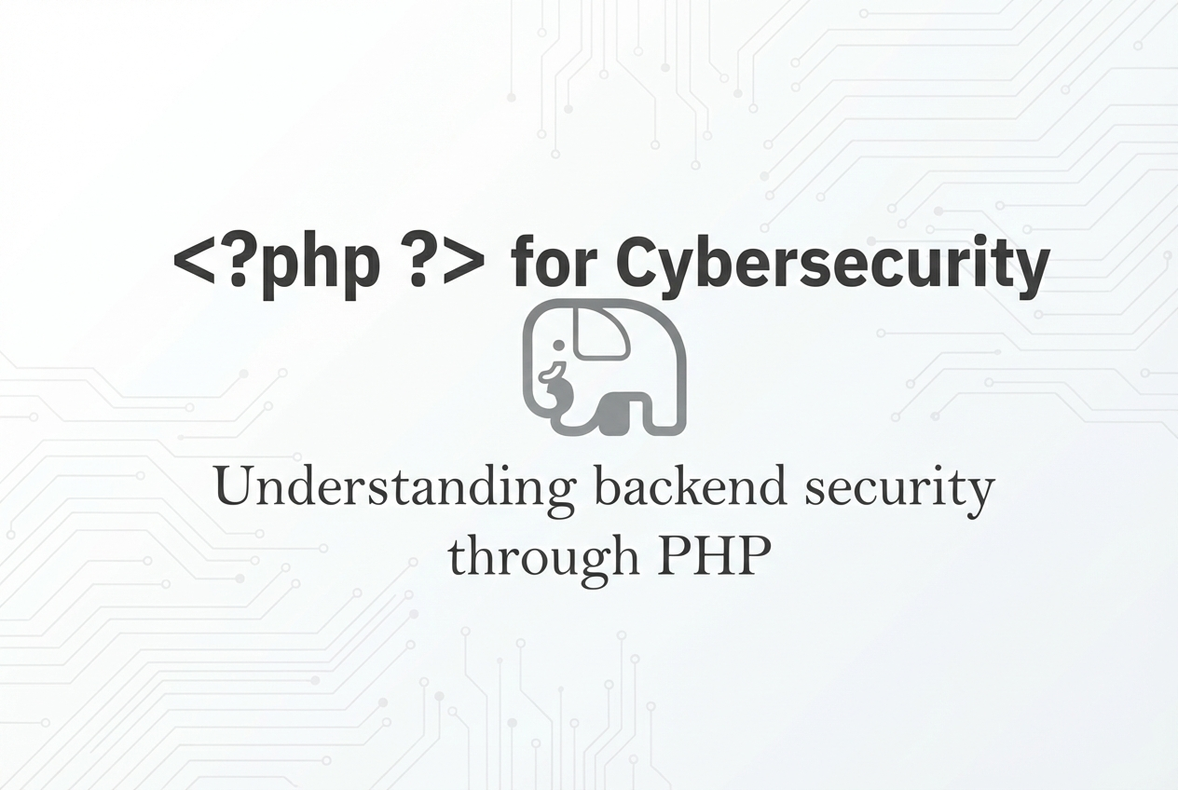

Slide 2
What is PHP?
PHP is a server-side scripting language used to build the backend of websites. It handles:
User input
Authentication
Database operations
File uploads
Sessions
Because PHP runs on the server, most critical vulnerabilities live here.

Slide 3
Why PHP Matters in Cybersecurity
Many websites use PHP + MySQL
Critical vulnerabilities exist in backend code
Understanding PHP helps find and fix security flaws

Slide 4
PHP Attack Surface
User input handling (GET/POST)
Database queries
File uploads
Session management
Command execution

Slide 5
Cross-Site Scripting (XSS) Vulnerability
Vulnerable code:
<?php
echo $_GET['name'];
?>
Here the Problem is, User input is printed directly, allows script injectionVulnerable Code Secure Code
<?php
echo htmlspecialchars($_GET['name']);
?>

Slide 6
SQL Injection
Vulnerable code:
$query = "SELECT * FROM users WHERE username='$user' AND password='$pass’”;
Here the User input directly added to SQL query, can bypass login
Secure Code (Prepared Statement)
$stmt = $conn->prepare("SELECT * FROM users WHERE username=? AND password=?");
$stmt->bind_param("ss", $user, $pass);
$stmt->execute();

Slide 7
File Upload Vulnerability
Vulnerable Code
move_uploaded_file($_FILES['file']['tmp_name'], "uploads/" . $_FILES['file']['name']);
In this, any file type allowed, can upload web shells
Secure Code
$allowed = ["jpg","png","pdf"];
$ext = pathinfo($_FILES['file']['name'], PATHINFO_EXTENSION);
if(in_array($ext,$allowed)){
move_uploaded_file($_FILES['file']['tmp_name'], "uploads/" . basename($_FILES['file']['name']));
}

Slide 8
Session Hijacking
Weak Code
session_start();
Secure Code
session_start();
session_regenerate_id(true);
Prevents session fixation and hijacking

Slide 9
Command Injection
Vulnerable Code
system("ping " . $_GET['ip']);
It executes user input as system command
Secure Code
$ip = escapeshellarg($_GET['ip']);
system("ping " . $ip);

Slide 10
Why Hackers Learn PHP
Understand backend logic
Identify insecure coding patterns
Secure real-world applications
Move beyond tool-based hacking

